Slide 1
Verizon Data Services India Pvt. Ltd.
Hackathon - DevOps

Slide 2
DevOps Implementation
Dashboard for
Request tracking

Slide 3
Agenda
Introduction
Implementation
Results
Next steps

Slide 4
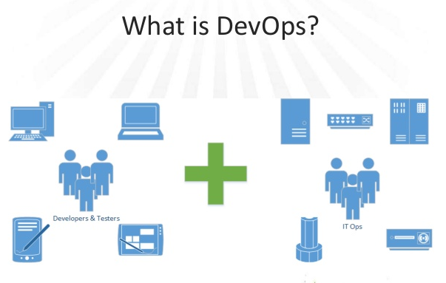
Introduction
DevOps (a combination of development and operations) is a software development method that stresses communication,collaboration and integration between software developers and information technology(IT) professionals thereby– Enable rapid evolution of products or services– Reduce risk, improve quality across portfolio, and reduce costs

Slide 5
Implementation
Integrated Dashboard
Request tracking mechanism
Visual representation of request status
Feedback on request validity
Development with Eclipse integrated to Github
Source code maintenance in GitHub
Continuous process integration using Travis
Direct application deployment in CloudFoundry

Slide 6
Results
Web application developed in eclipse and committed to Github
Automated build and deployment triggered through Travis-CI
Application deployed to Pivotal.Io webservice host
Build will be triggered for any changes committed to Github for the specific application branch
Application can be accessed through the following url,
  URL: http://dashboardrequest.cfapps.io/main.jsp

Slide 7
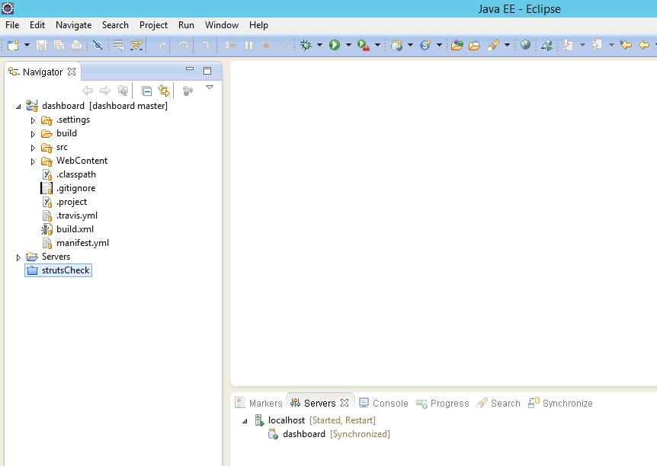
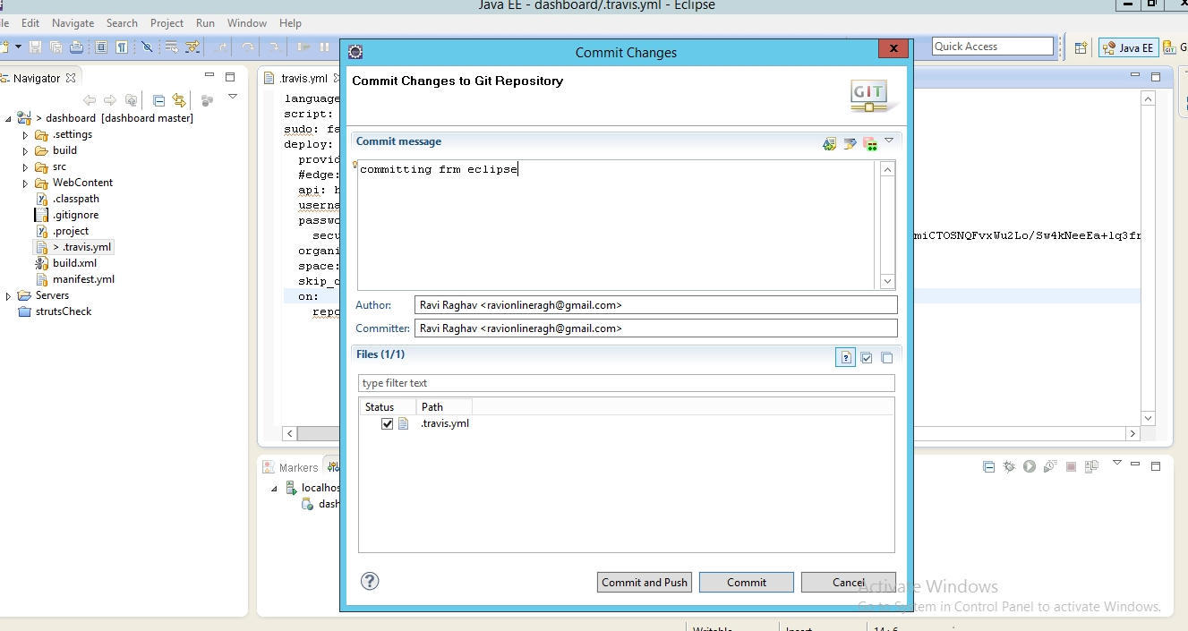
Eclipse
Application build and Github integration

Slide 8
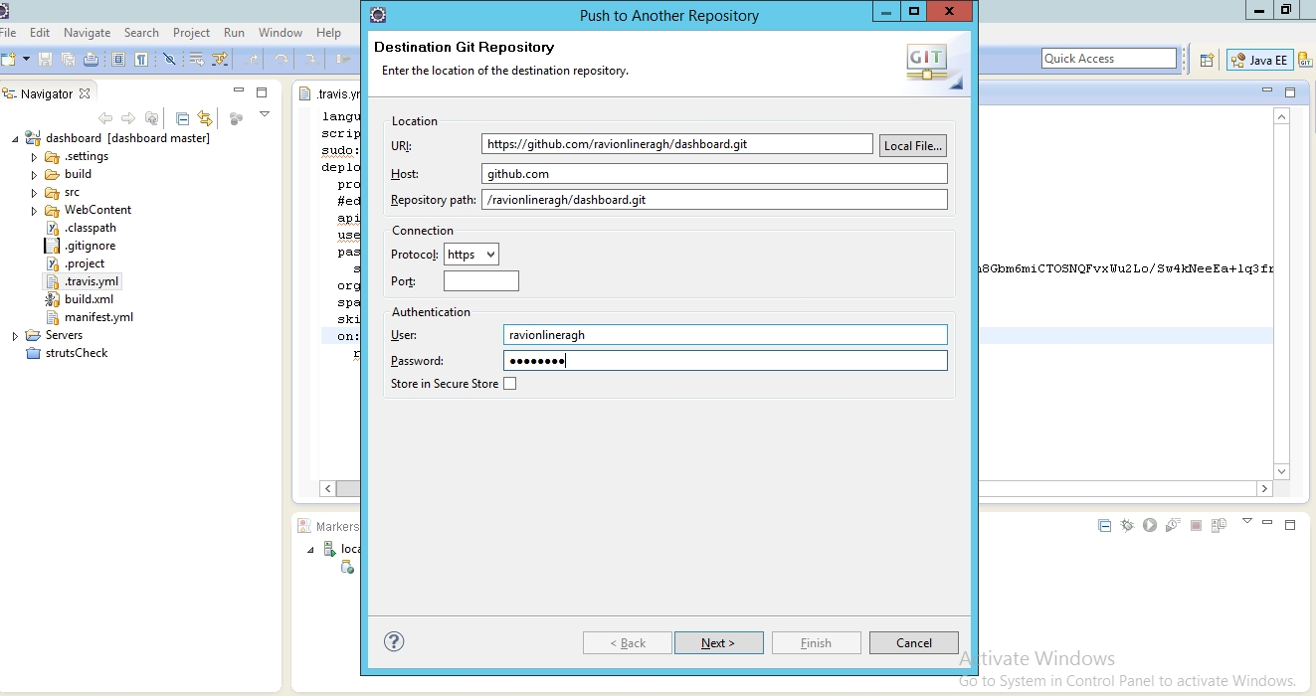
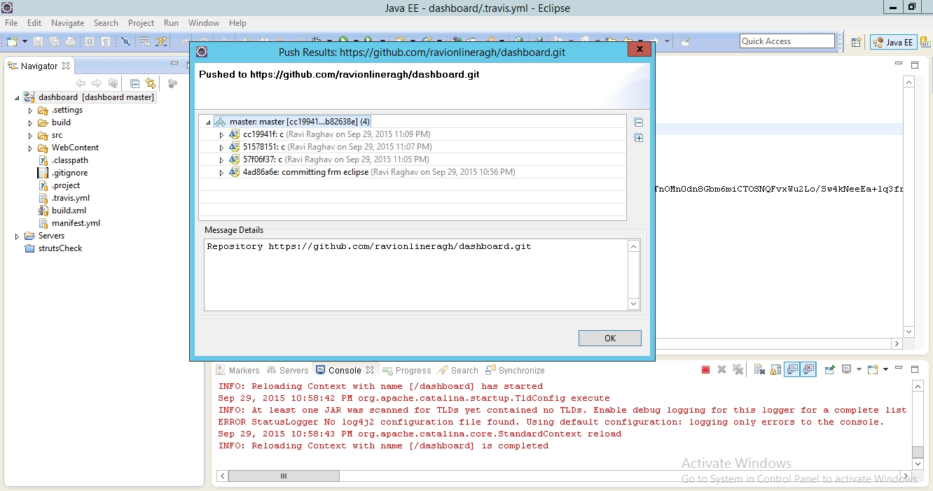
Eclipse - 2

Slide 9
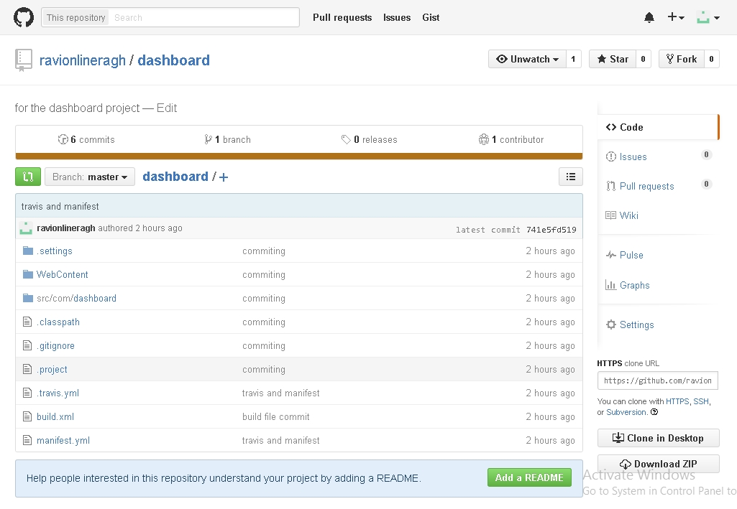
GitHub

Slide 10
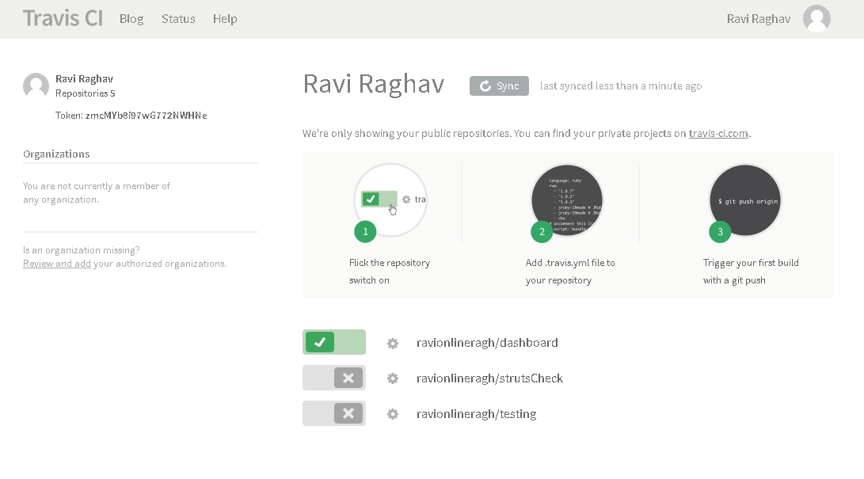
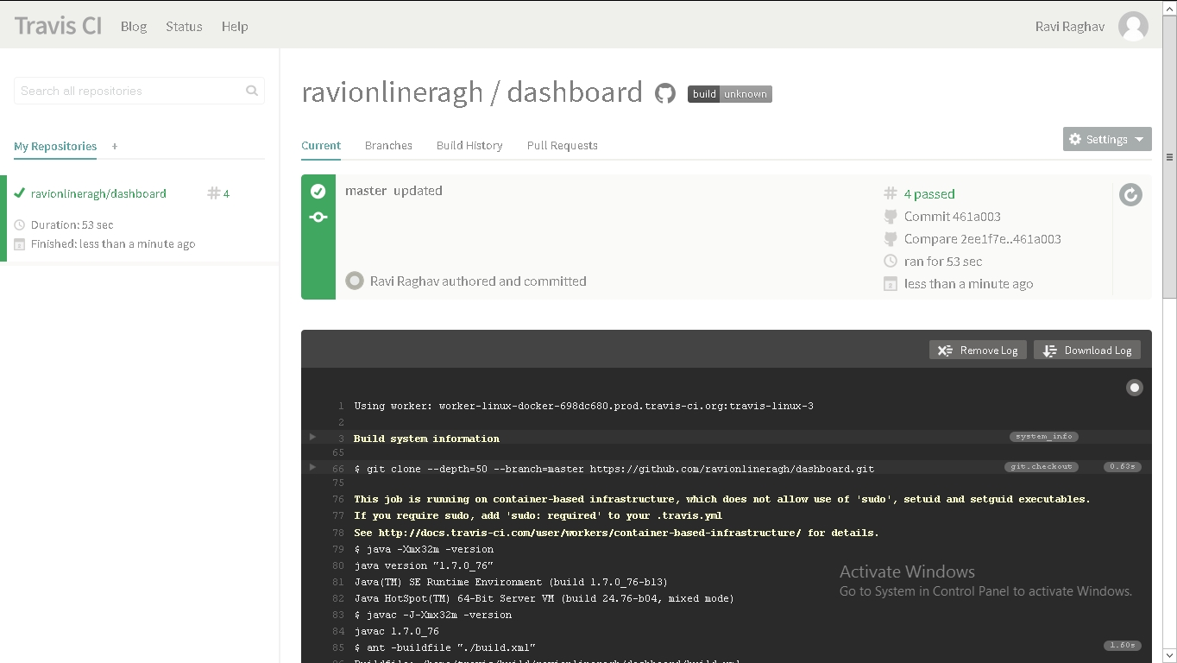
Travis

Slide 11
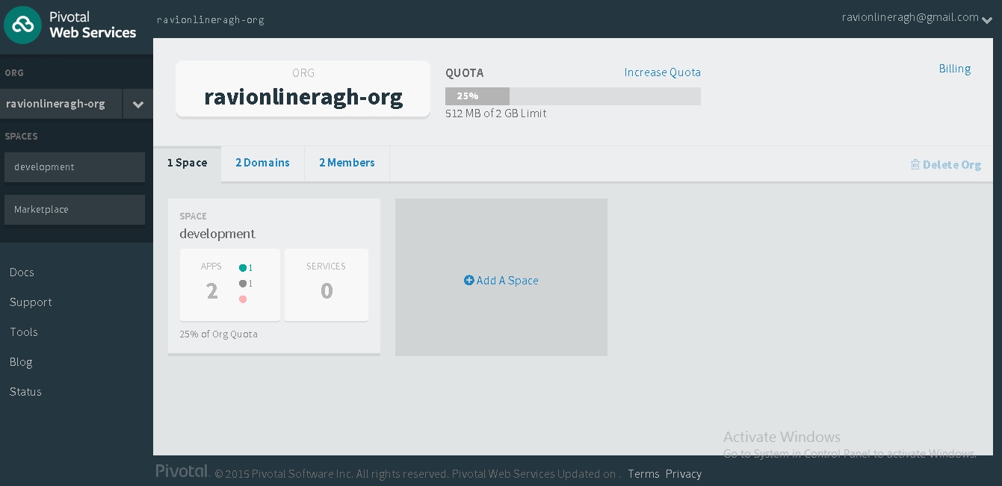
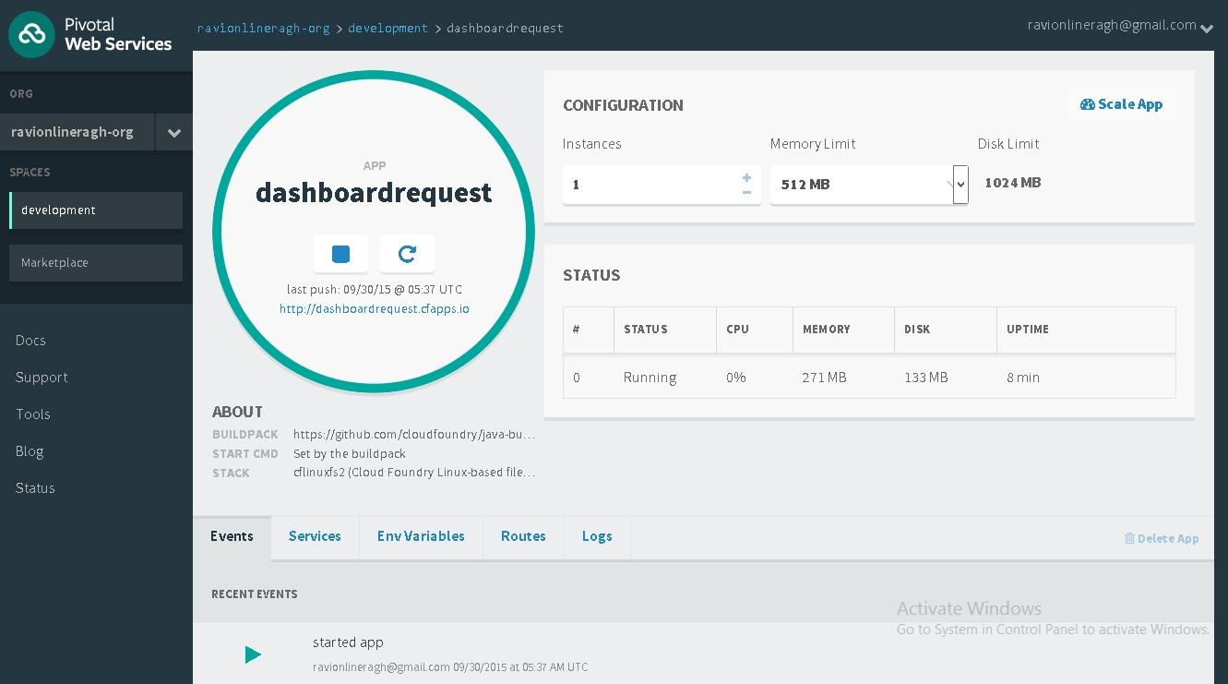
Pivotal

